Slide 1
Hello World!

Slide 2
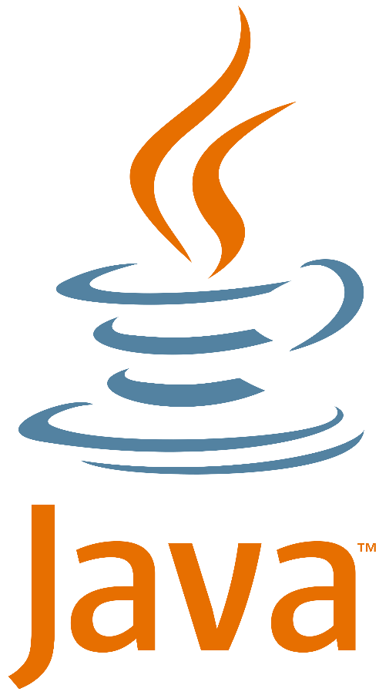


Today’s agenda
Jumping into coding:
Define programming: what is it?
Introduce the Java programming language.
Discover how to install, read about, and work with Java.
Begin simple Java programming using NetBeans.

Slide 3
Beginning programming
What’s a program?

Slide 4
So, what’s a program? (part 1.)
Conceptually, a program is a simple thing - a sequence of instructions (called statements) in a programming language.
These can be:
Operators (like +, -) and operands
Expressions
Assignments
Keywords
int x = 10;
int y = 20;
int z = x + y;
System.out.println(z);

Slide 5
So, what’s a program? (part 2.)
We need to be very precise when we write programs because…

Slide 6
So, what’s a program? (part 3.)
…computers don’t think! They don’t truly understand the program you write, only how to run it! They have no notion of context; they will do as you tell them – nothing more and nothing less.

Slide 7
So, what’s a program? (part 4.)
We call the grammar of a program its syntax.
We call the meaning of program its semantics.
For example, in mathematics, 5(2) has different syntax to 5×2, but the same semantics⁠⁠: 5 multiplied by 2!
int x = 10;
int y = 20;
int z = x + y;
System.out.println(z);

Slide 8
A generic program (part 1.)
Input
Keyboard
Mouse
Processing
Software
Output
Screen
Network
Printer
Hardware

Slide 9
A generic program (part 2.)
Input
Keyboard
Mouse
Processing
Software
Output
Screen
Network
Printer
Hardware
This is what we are interested in!

Slide 10
Programs are just instruction lists
Remember this program on the right from before?
It’s a sequential list of instructions.
It says:
Put the value ‘10’ in ‘x’
Put the value ‘20’ in ‘y’
Add ‘x’ to ‘y’ and put it in ‘z’
Give ‘z’ as program output
int x = 10;
int y = 20;
int z = x + y;
System.out.println(z);

Slide 11
Programs are just equations!
Don’t get worried, this will become clear!
All a program does is take input from the user, change (or, more technically, transform) the data and give it as output.
On the right, there’s a mathematical equation specifically a function definition (not a Java one, we’ll get to that later!).
See how it works? Depending on what we give as x, we get a different answer!
Here, x is the input, f is the program, and the right-hand side is the output.
f(x) = x × 2
f(2) = 4
f(10) = ?

Slide 12
Here’s the Java equivalent
Mathematical equation
Java implementation
f(x) = x × 2
Scanner scan = new Scanner(System.in);
int x = scan.nextInt();
scan.close();
int ans = x * 2;
System.out.println(ans);

Slide 13
Professional programmer?

Slide 14
Professional Programmers (part 1.)
Anyone can learn programming, but persistence is required.
Programming is a skill that must be practiced, like a foreign language.
Always ask for help if you are struggling – there is no such thing as a daft question.
Now a task for you! List five attributes of a Professional Programmer.

Slide 15
Professional Programmers (part 2.)
Some helpful online resources:
8 Characteristics of a Software Developer at Atomic.
What is a Professional Programmer?
7 qualities that differentiate a great programmer from a good programmer.
How many did you get? Did you have any others in mind?

Slide 16
Getting started with Java!
Java: Who, What, Where and Why?

Slide 17
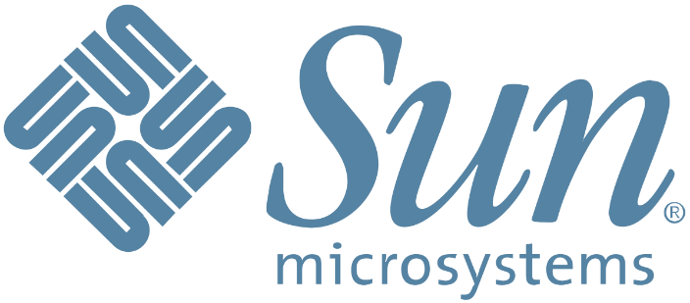
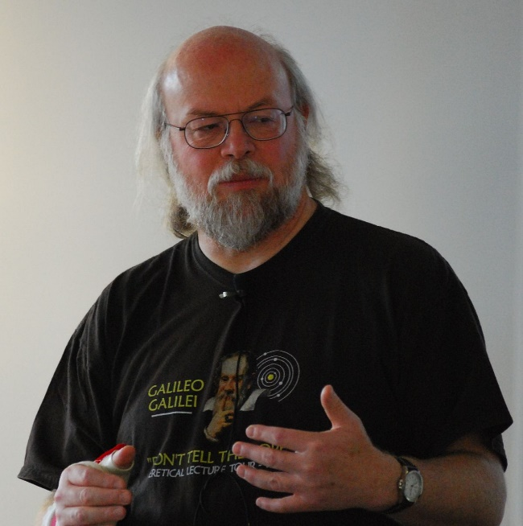
Java: Origins (part 1.)
Java was originally developed by James Gosling at Sun Microsystems (which has since been acquired by Oracle) and released in 1995 as a core component of Sun Microsystems' Java platform.
Java is a high-level, class-based, object-oriented programming language that is designed to have as few implementation dependencies as possible.
It is a general-purpose programming language intended to let programmers write once, run anywhere (WORA).
Java applications are typically compiled to bytecode that can run on any Java virtual machine (JVM) regardless of the underlying computer architecture.

Slide 18
Java: Origins (part 2.)
Java is an interpreted language.
This means that additional software is required to run Java programs.
Java programs are written in plain text. That’s right, all you need to write Java code is Notepad! However, unlike some other interpreted languages, we must compile our Java programs to bytecode before running.
To run and compile Java programs we need the Java Development Kit, available here.
Integrated Development Environments (IDEs) make writing and compiling Java a very simple process.

Slide 19

Why learn Java?
Plenty of languages to pick from (C++, C#, PHP, Ruby etc.)
Java is great because:
It is platform independent (write once, run anywhere).
It has an excellent set of free development tools.
It is object-oriented (OO).
It is easier to learn than some other OO languages (e.g. C++).
Consistent with other modules, for example Android application development in Agile Developer (year 2).
Java is everywhere.
It is secure, multi-threaded, and robust.

Slide 20




Java job prospects
One very important reason - the ability to program in Java is a marketable skill
C# and Java are the programming languages most in demand in the UK.
The languages are near identical.
If you learn Java you can convert to C# easily, and vice versa.
We picked the most mature language.
The average salary for a permanent IT job matching ‘JAVA’ in the last 6 months was £50,000.
The average salary for a permanent graduate developer job in the last 6 month was £27,500 (UK excluding London).
Keep track of IT jobs and in-demand skills here.

Slide 21
Hello World!
The first program most programmers implement when dealing with a new language.

Slide 22

Any drawbacks?
Java can be slower than compiled native languages (e.g. C++) that are converted to raw machine code before they are run.
Due to its interpreted nature requiring the JVM, application memory usage tends to be higher.
Limited control of the memory space (automatic garbage collection).

Slide 23
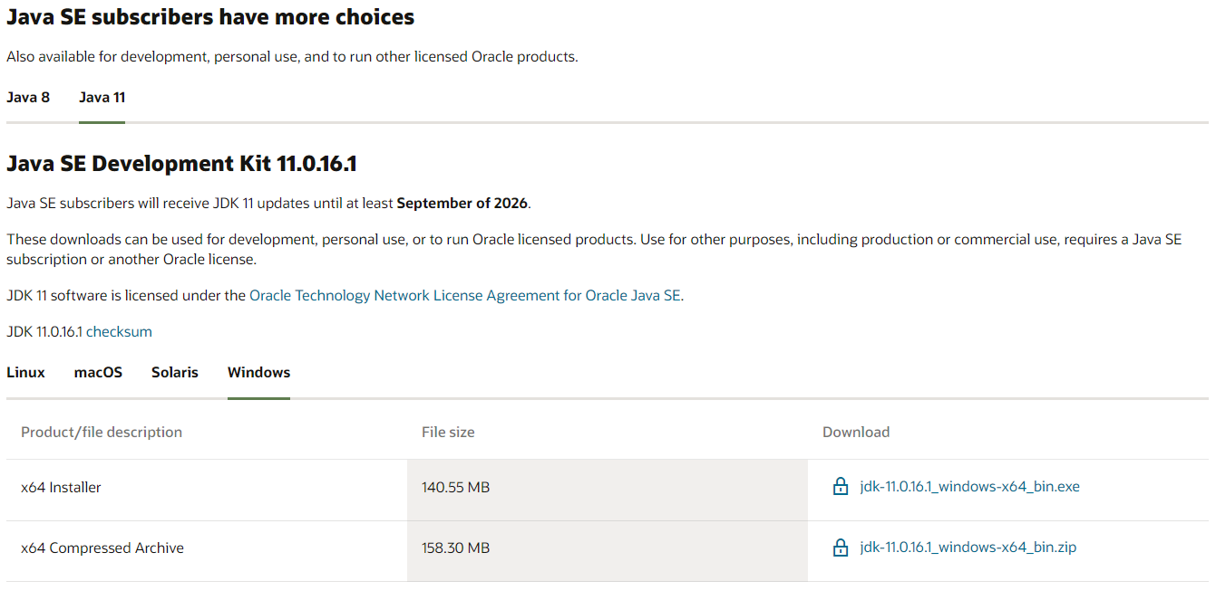
Where can I get Java?

Slide 24

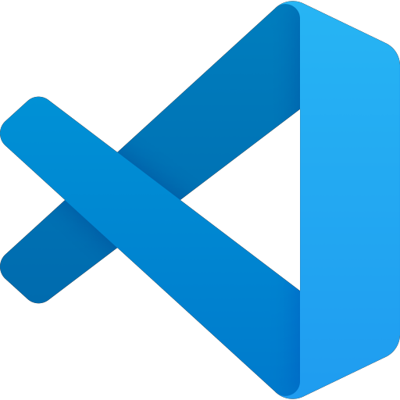
Getting set up with an IDE
An IDE, or Integrated Development Environment, is a text editor that will allow you to write and run programs from one piece of software. Some Java IDEs include:
NetBeans by Apache: Highlights source code syntactically and semantically, lets you easily refactor code, provides a range of handy and powerful tools: We’ll be using this!
Eclipse: freely available and popular alternative that describes itself as “the leading open development platform”.
Visual Studio Code: Provides Java support through extension. Developed by Microsoft, is open source, and free to download.

Slide 25
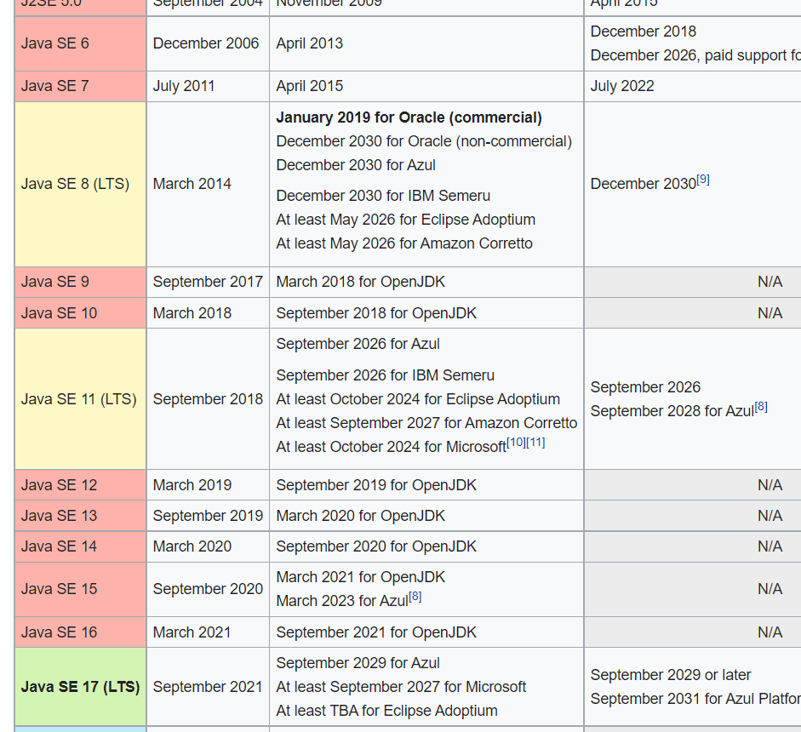
Which Java?
The labs (both Windows and Linux) use Java version 11.
On Linux, Java (along with NetBeans) is installed locally. On Windows, you can run NetBeans from AppsAnywhere.
Do not install any other version (i.e. 8)!

Slide 26
A quick demo
We’re going to write our first program(s) together now.

